Slide 1


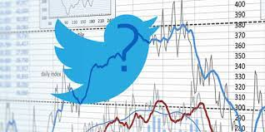
STOCK MARKET ANALYSIS USING TWITTER (SENTIMENT ANALYSIS)
BY:
A ABHINAV REDDY
N ABHISHEK
A SAI KUMAR GOUD
GUIDED BY:
Dr. K MADHUSUDHANA SIR

Slide 2
ABSTRACT & INTRODUCTION
Predicting stock market movements is a well-known problem of interest. Now-a-days social media is perfectly representing the public sentiment and opinion about current events. Especially, Twitter has attracted a lot of attention from researchers for studying the public sentiments.
So, we apply sentiment analysis and machine learning principles to find the correlation between “public sentiment” and “market sentiment”.
Previous studies have concluded that the aggregate public mood collected from Twitter may well be correlated with Dow Jones Industrial Average Index (DJIA).

Slide 3
Cont..
Such that, we use twitter data to predict public mood and use the predicted mood and previous days’ DJIA values to predict the stock market movements.
In an elaborate way, positive news and tweets in social media about a company would definitely encourage people to invest in the stocks of that company and as a result the stock price of that company would increase.
At the end of this project, it is shown that a strong correlation exists between the rise and falls in stock prices with the public sentiments in tweets.

Slide 4
REQUIREMENTS:
Functional Requirements:
Functional requirement are the functions or features that must be included in any system to satisfy the business needs and be acceptable to the users. Based on this, the functional requirements that the system must require are as follows:
System should be able to process new tweets stored in database after retrieval
System should be able to analyze data and classify each tweet polarity.
Non-Functional Requirements:
User friendly
System should provide better accuracy
To perform with efficient throughput and response time

Slide 5

SOFTWARE REQUIREMENTS:
Software Requirements are:
Jupyter Notebook/pycharm
Google colab which we can share code on cloud.
Operating System:Windows OS/MACOS

Slide 6
HARDWARE REQUIREMENTS:
RAM : 4GB RAM and above
Hard Disk : 5GB and above
Processor : Dual core processor and above

Slide 7
Libraries used:
Numpy:
NumPy is a library for the Python programming language, adding support for large, multi-dimensional arrays and matrices, along with a large collection of high-level mathematical functions to operate on these arrays
Pandas:
Pandas is a software library written for the Python programming language for data manipulation and analysis.
VADER ( Valence Aware Dictionary and Sentiment Reasoner ):
The VADAR sentiment analysis under the library nltk (The Natural Language Toolkit).
By using we get the compound value it will tell whether the statement is overall negative or positive.
Scikit-learn
Scikit-learn (Sklearn) is the most useful and robust library for machine learning in Python. It provides a selection of efficient tools for machine learning and statistical modeling including classification, regression, clustering and dimensionality reduction via a consistence interface in Python. This library, which is largely written in Python, is built upon NumPy, SciPy and Matplotlib.
From this library, we are importing the Random forest Regressor

Slide 8
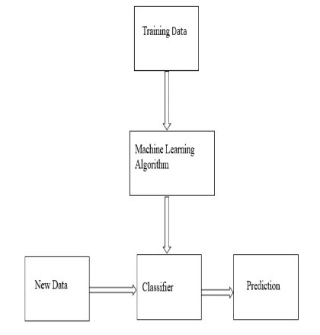
Plan of action:
Data Collection & Parsing:
The stock market data is collected using yfinance API and tweets are fetched from twitter. In this step the preprocessing of the tweets such as removing stop words, hyperlink and other steps are carried out.
Sentiment Analysis:
The sentiment analysis of the tweet is carried out using VADER. Here each tweet is given a sentiment score which determines if the tweet is positive, negative or neutral.

Slide 9
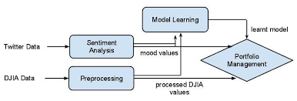
Cont…
Processing:
The rows which have missing values such as price values are further processed. The data along with the sentiment scores is divided into train and test data and is fed to the model.
Applying Regression Models:
To predict stock Market prices, we have used Random Forest and Support vector regression models in this project. We will be then using RMSE scores to validate the efficiency of our models and to analyze which model works better for the used dataset.

Slide 10
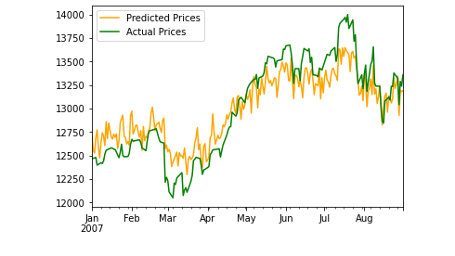
Sample output screenshot:

Slide 11
CONCLUSION AND FUTURE SCOPE:
In this paper we investigated how sentiment analysis of the twitter data is correlated to the prediction of the stock market price for all the companies which are taken.
The result obtained after the prediction process clearly specifies that, we have obtained the accurate value which matches with the actual stock price appropriately.
Thus, social media such as twitter can be used as a source to predict the stock market price with maximum accuracy.

Slide 12
Cont…
Thus, using sentiment analysis of twitter data and stock data from yahoo finance API, we predict the stock market price which is helpful for predicting future stock price.
As our analysis is limited, expansion to broader set of companies or all Twitter data might yield more insights into the data, leading to more effective application in stock price prediction.

Slide 13



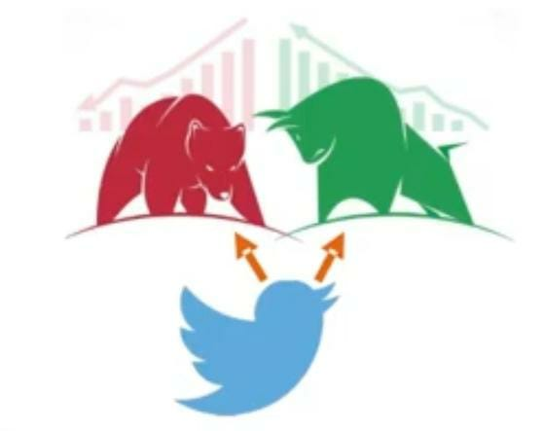
Thank You!

